Slide 1

Department of CSE-AI & ML (CSM)
Team:BATCH06
21BQ1A4243, 21BQ1A4213,
21BQ1A4220, 21BQ1A4254
Project Title:
ASCEND: Advanced Support for Career Exploration and Navigating Directions
TEAM MEMBERS:
21BQ1A4243 – G. Lalitha Sri
21BQ1A4220 – B. Likith Kiran Singh
21BQ1A4213 – Bhargava Durga Prasad. G
21BQ1A4254 – J. Leela Satya Ajith Vardhan
Under the Guidance of:
(Project Guide) HOD-CSM,
Dr. V. Muralidhar Dr.K.Suresh Babu

Slide 2
Department of CSE-AI & ML (CSM)
Team:BATCH06
21BQ1A4243, 21BQ1A4213,
21BQ1A4220, 21BQ1A4254
Abstract:
ASCEND – Advanced Support for Career Exploration and Navigating Directions is a comprehensive AI-driven career guidance platform designed to help students, job seekers, and aspiring entrepreneurs make informed decisions about their future careers. The system leverages Deep Learning, Natural Language Processing (NLP), and interactive recommendation engines to provide personalized career suggestions, mentorship, startup insights, and educational resources.
The platform addresses the lack of structured and accessible career counseling by providing a virtual mentor chatbot, AI-based resume assessments, career role prediction models, and a rich resource portal. Users can explore government and private job listings, startup ideas, industry trends, and suitable learning resources tailored to their skills and goals. ASCEND aims to bridge the career gap and empower individuals with real-time, personalized career planning tools.
The current systems often lack real-time mentorship, personalization, and inclusivity across diverse career stages. Many students rely on outdated career assessments or social influence, leading to mismatched jobs, unemployment, or dissatisfaction. Additionally, existing tools rarely integrate course recommendations, interview practice, and market trends in one place.

Slide 3
Department of CSE-AI & ML (CSM)
Team:BATCH06
21BQ1A4243, 21BQ1A4213,
21BQ1A4220, 21BQ1A4254
ASCEND solves these challenges by offering:
1.AI-powered role prediction based on user inputs or uploaded resumes.
2.Chatbots for mock interviews and mentorship using NLP and Gemini API.
3.Semantic search to recommend courses based on desired skills.
4Public and private sector job discovery using APIs.
5.Startup ecosystem tracking and innovation support. This platform ensures that every user, regardless of their background, receives intelligent, inclusive, and timely guidance to achieve their career ambitions.
Functional Requirements :
User Registration and Profile:
Allow users to create accounts using email or continue with google.
Implement password recovery and account verification processes.
This module manages user authentication and authorization, ensuring secure access to the platform's features.
Career Role Prediction:
Predicts suitable job roles using Random Forest and Word2Vec models based on user-provided data.
Accepts input through structured forms or by analyzing uploaded resumes.
Suggests best-fit career titles along with confidence levels for better decision-making.

Slide 4
Department of CSE-AI & ML (CSM)
Team:BATCH06
21BQ1A4243, 21BQ1A4213,
21BQ1A4220, 21BQ1A4254
Mentor and Interview Bots:
Provides an interview chatbot that simulates mock interviews using NLP techniques.
Offers a mentor bot powered by Gemini API that answers career-related questions.
Delivers personalized feedback based on interview answers and suggests suitable job roles.
Government and Private Job Discovery:
Allows exploration of 30+ government sectors, including job roles, skills, and qualifications required.
Filters private and NGO jobs by job role, location, company name, or user-entered skills.
Uses Gemini API and Rapid API integration to parse resumes and fetch matched job listings.
Career Compass (Student Support):
Provides career guidance for students after 10th, 12th, and graduation based on academic choices
Describes different streams, required qualifications, and related job opportunities..
Helps users understand future paths through structured career roadmaps.
6. Startup Ideas Module:
Displays trending startup ideas across industries with detailed insights.
Allows users to submit their own startup ideas and receive community feedback.
Shows real-time startup-related news and trends using the News API.

Slide 5
.
Department of CSE-AI & ML (CSM)
Team:BATCH06
21BQ1A4243, 21BQ1A4213,
21BQ1A4220, 21BQ1A4254
7. Course Recommender (Learn Page):
Uses Hugging Face semantic search to recommend online courses based on user interests.
Presents course results with title, rating, difficulty, duration, and external access links.
Helps users identify skill gaps and find relevant upskilling resources efficiently.
8. User Profile and Blogs:
Enables users to create a detailed profile with name, bio, skills, and social links.
Allows publishing of user-generated blogs and viewing posts shared by others.
Builds a network-friendly profile that supports visibility and engagement within the platform.
9. Search and Filtering Functionality:
Provides a universal search bar on the landing page for querying jobs by title, skills, companies, or locations.
Enables real-time filtering of job opportunities across government, private, and startup sectors.
Integrates API-based results with pagination for seamless exploration of relevant job listings.

Slide 6
Department of CSE-AI & ML (CSM)
Team:BATCH06
21BQ1A4243, 21BQ1A4213,
21BQ1A4220, 21BQ1A4254
Software Requirements:
1. UI Design: Figma
2. Code Editor: Visual Studio Code
3. Programming Languages: HTML, CSS, JavaScript, Python(Flask)
4. Frontend Technologies: React.js
5. Data Structures: JSON,XML
6. Machine Learning: Scikit-learn, Word2Vec, Hugging Face Transformers
7. APIs & Cloud:
Gemini API (Interview + mentor bots)
Rapid API (Job Listing)
News API, Wiki API
Google Analytics (user tracking)
Firebase (database)
8. API Testing: Postman Application

Slide 7
Department of CSE-AI & ML (CSM)
Team:BATCH06
21BQ1A4243, 21BQ1A4213,
21BQ1A4220, 21BQ1A4254
Hardware Requirements:
1.OS: Windows/Linux/Mac (for development)
2.Browser: Chrome/Firefox (latest version for deployment)
3. RAM: Minimum 4Gb
4. HDD: 1Tb
5. GPU: 1Gb (recommended for local ML testing)
6. Net-Bandwidth: Minimum 5 Mbps for real-time API fetching, deployment, and database sync.

Slide 8
Department of CSE-AI & ML (CSM)
Team:BATCH06
21BQ1A4243, 21BQ1A4213,
21BQ1A4220, 21BQ1A4254
Results:
The ASCEND platform effectively addresses the need for intelligent, inclusive, and personalized career guidance for a diverse user base including students, job seekers, and aspiring entrepreneurs. The application integrates all key modules such as career role prediction, resume-based interview preparation, career compass for students, mentorship support, course recommendation, and startup idea exploration to provide a holistic solution for career development.
Users are able to explore both government and private sector opportunities through structured listings and filters. The system supports skill-based job matching and leverages ML algorithms like Random Forest and Word2Vec to recommend career paths aligned with user abilities and aspirations. Real-time resume parsing further enhances job discovery by matching users with relevant roles across sectors.
The Career Compass module plays a vital role in guiding students after 10th, 12th, and graduation by helping them identify suitable academic streams and career paths based on interest and potential. Mentor and Interview bots powered by Gemini API and NLP models provide personalized assistance for interview preparation, career questions, and performance evaluation.
A major highlight of the platform is its semantic course recommendation engine, which uses Hugging Face embeddings to recommend online learning resources tailored to user goals. These results are displayed with course duration, difficulty, and direct access links, making upskilling accessible and efficient.
The Startup Ideas Module boosts entrepreneurial engagement by displaying trending startup concepts and allowing user submissions for community feedback. Additionally, the user profile and blogging system empowers users to share their experiences, showcase achievements, and build a professional identity.

Slide 9
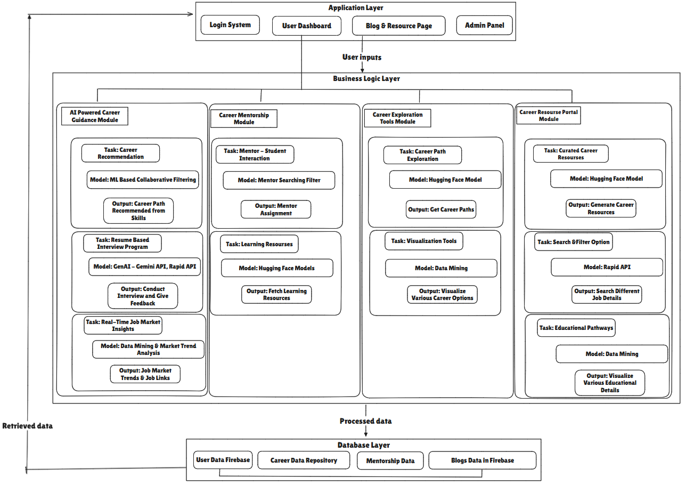
Department of CSE-AI & ML (CSM)
Team:BATCH06
21BQ1A4243, 21BQ1A4223,
21BQ1A4220, 21BQ1A4254
System Architecture

Slide 10

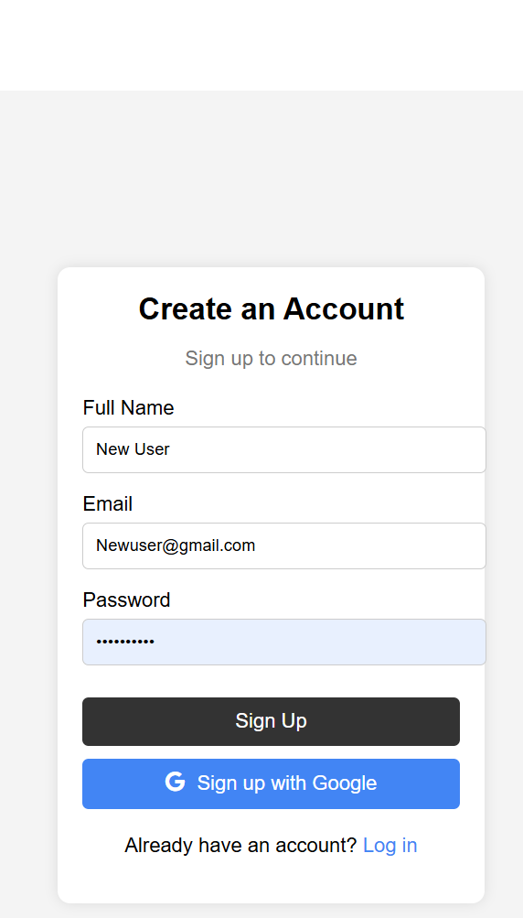
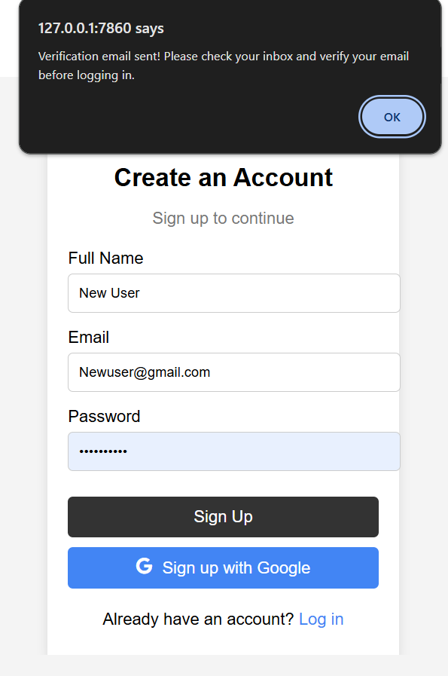
Department of CSE-AI & ML (CSM)
Team:BATCH06
21BQ1A4243, 21BQ1A4213,
21BQ1A4220, 21BQ1A4254
User Registration and Profile: Enables users to register via Gmail/social accounts, edit their bio, skills, and interests, and upload resumes, portfolio links, and learning goals.

Slide 11
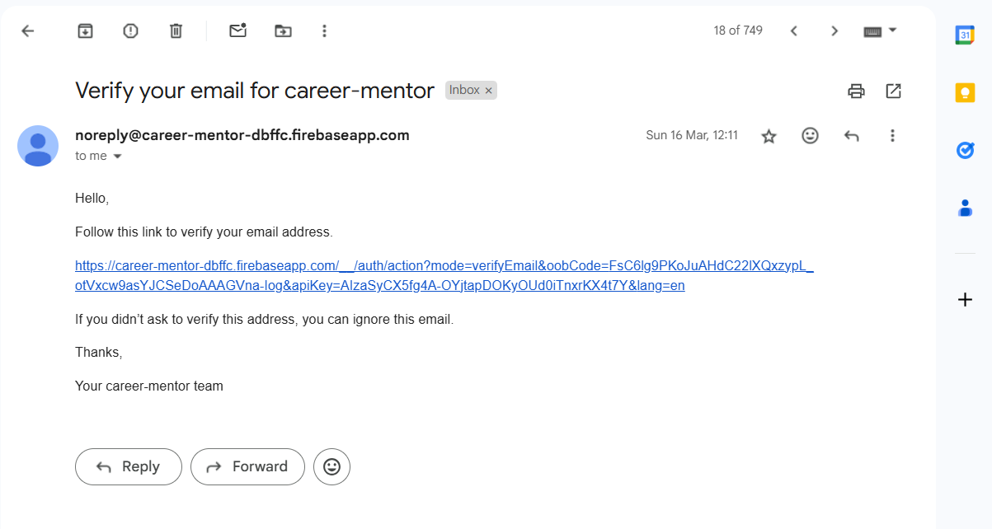
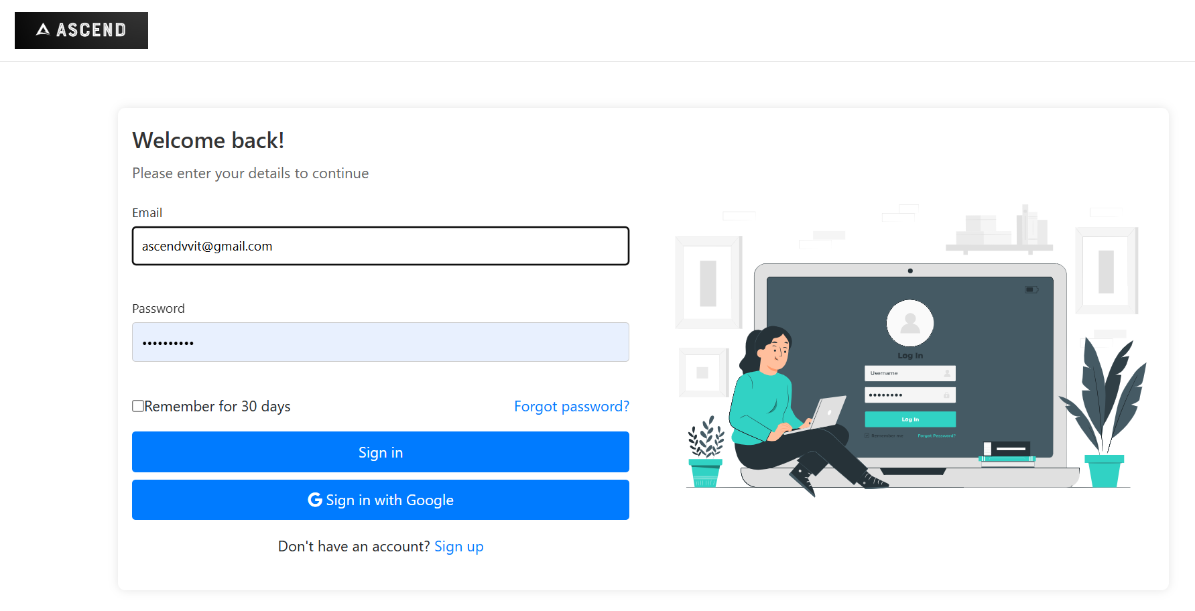
Department of CSE-AI & ML (CSM)
Team:BATCH06
21BQ1A4243, 21BQ1A4213,
21BQ1A4220, 21BQ1A4254

Slide 12
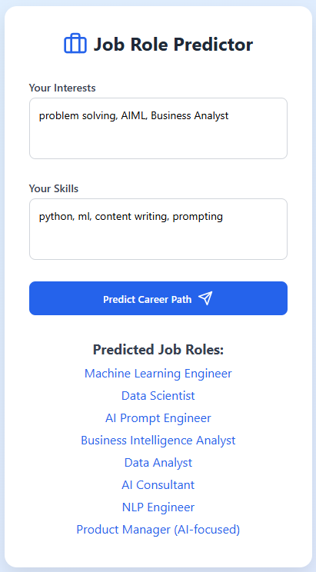
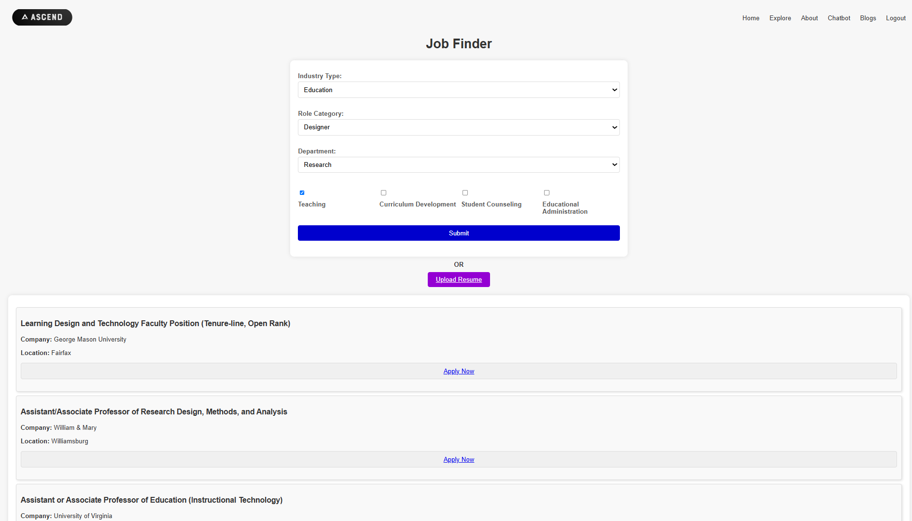
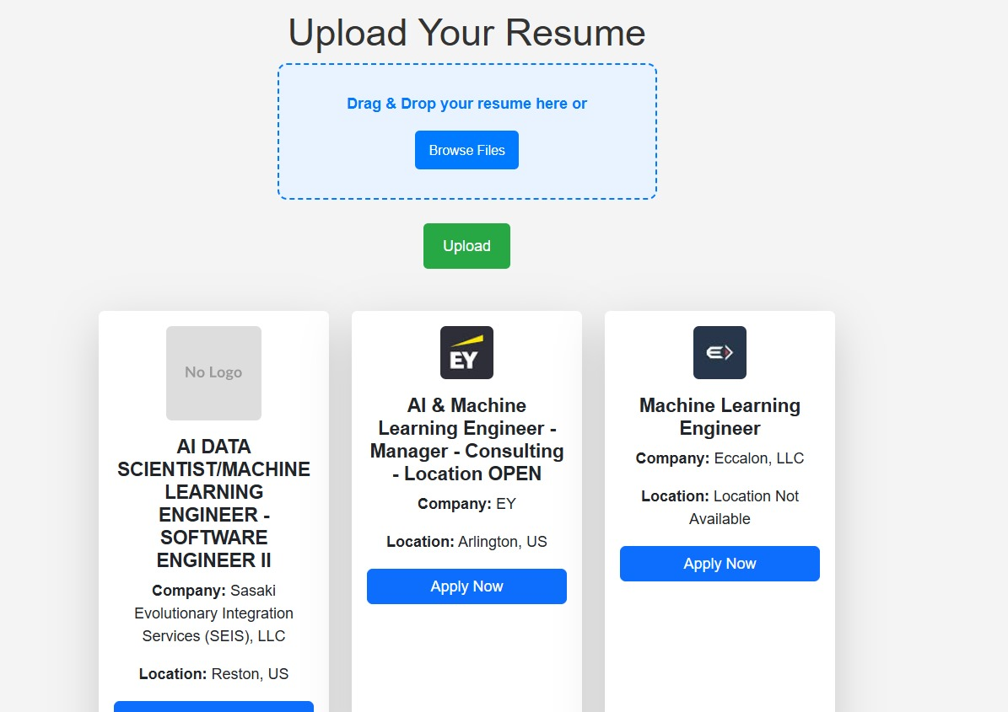
Department of CSE-AI & ML (CSM)
Team:BATCH06
21BQ1A4243, 21BQ1A4213,
21BQ1A4220, 21BQ1A4254
Career Role Prediction: Uses Random Forest and Word2Vec models to predict suitable job roles based on user inputs or resume uploads, providing career titles with confidence scores.

Slide 13
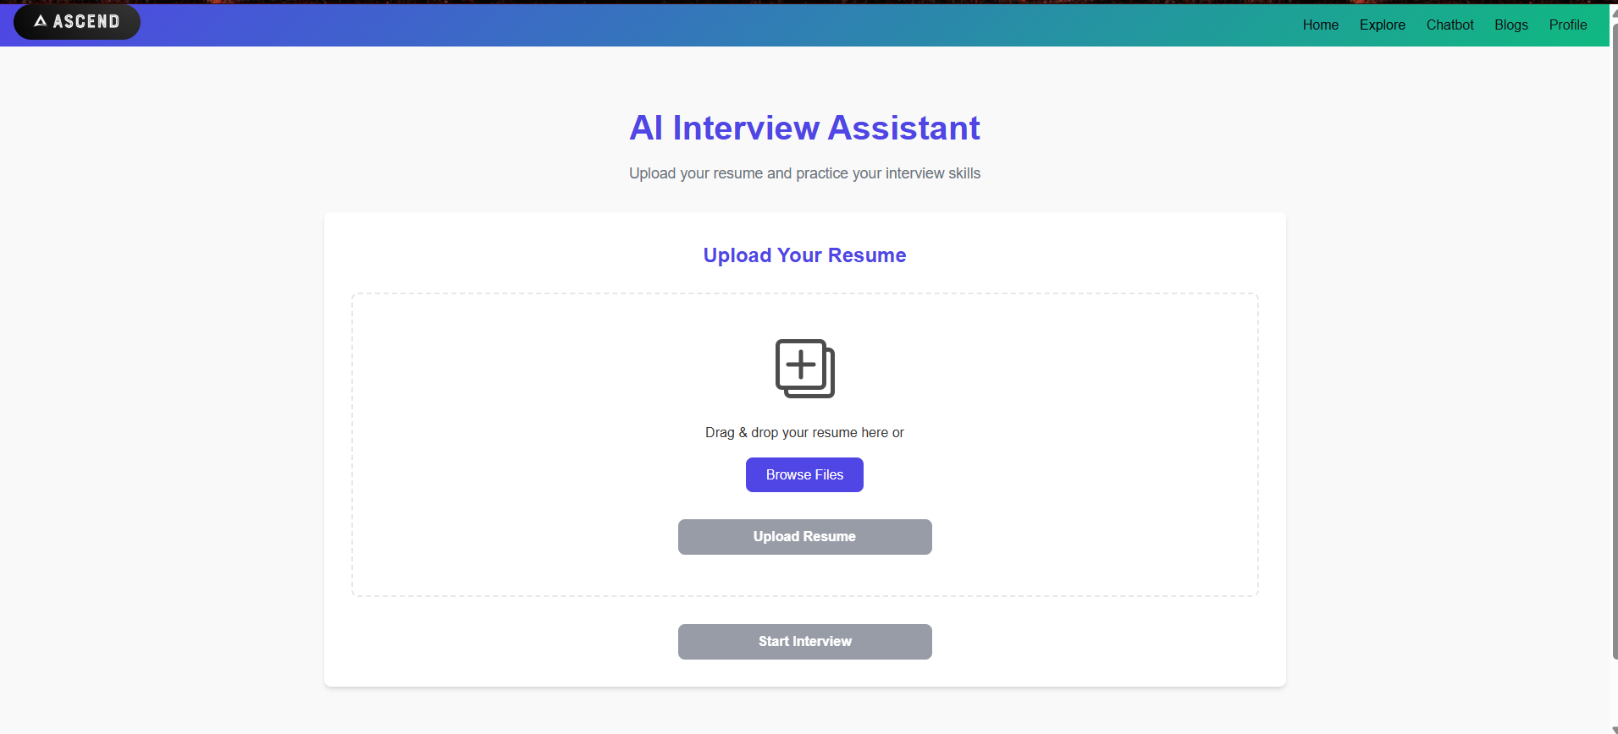
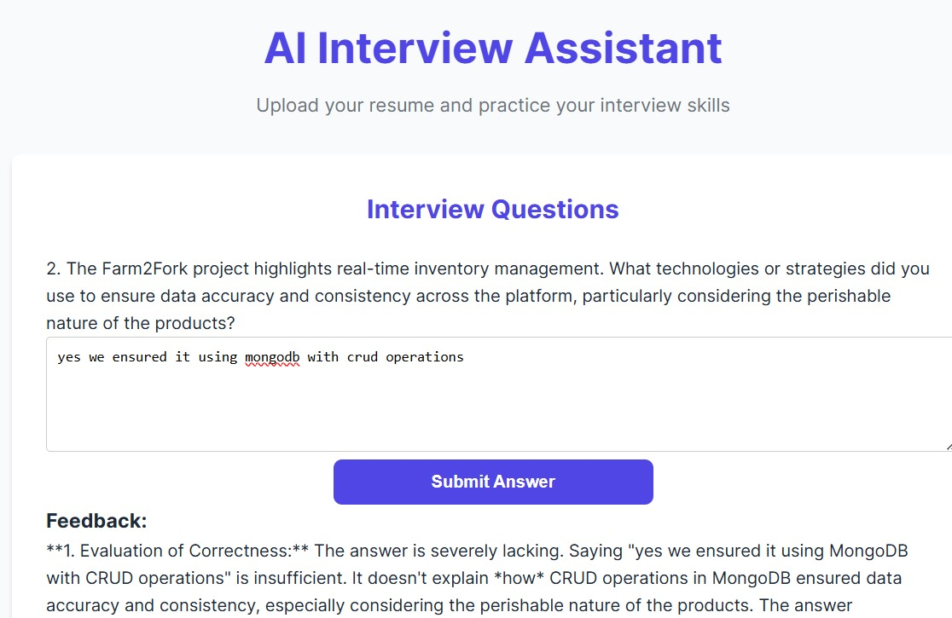
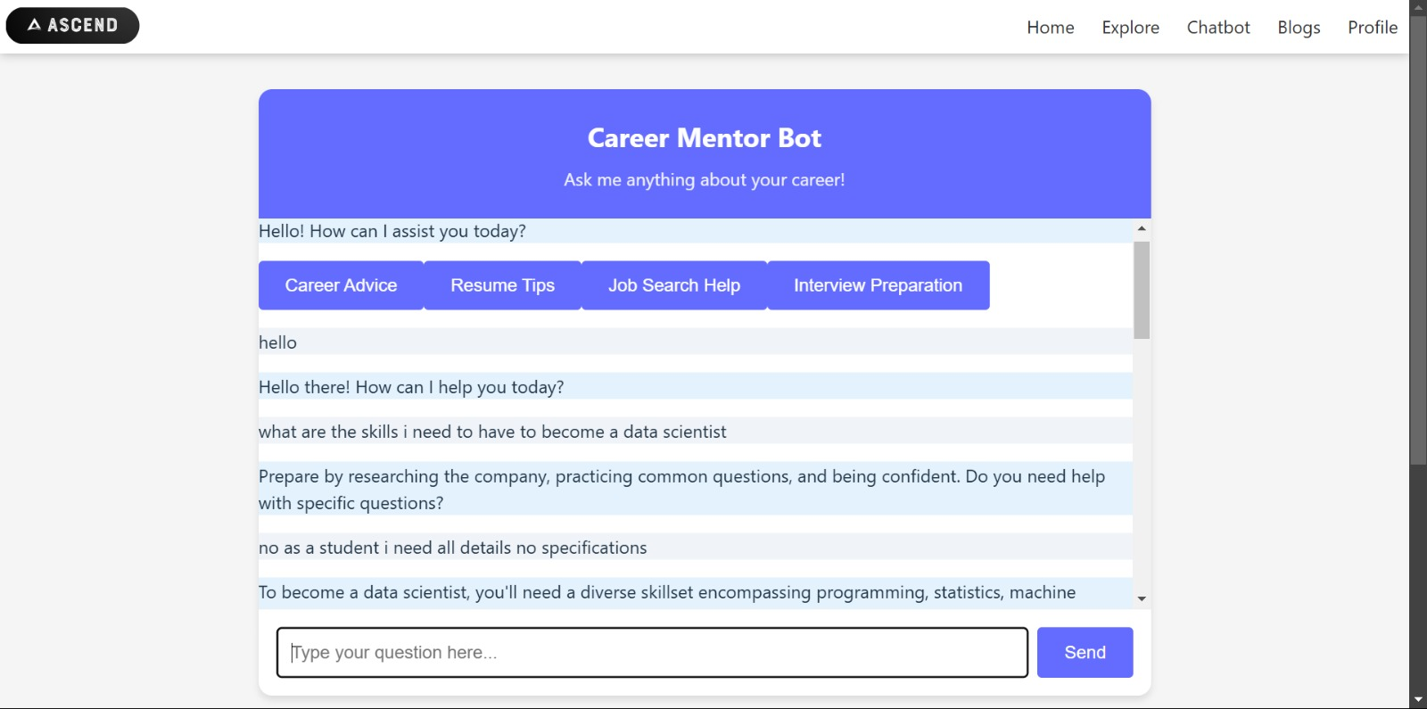
Department of CSE-AI & ML (CSM)
Team:BATCH06
21BQ1A4243, 21BQ1A4213,
21BQ1A4220, 21BQ1A4254
Mentor and Interview Bots:Includes an NLP-powered interview chatbot for practice and a Gemini API-based mentor bot that answers career queries and offers feedback on responses.

Slide 14
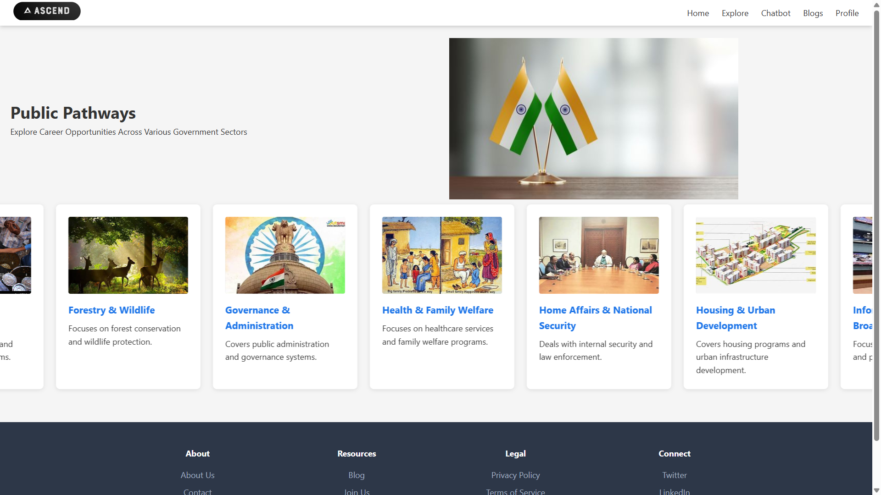
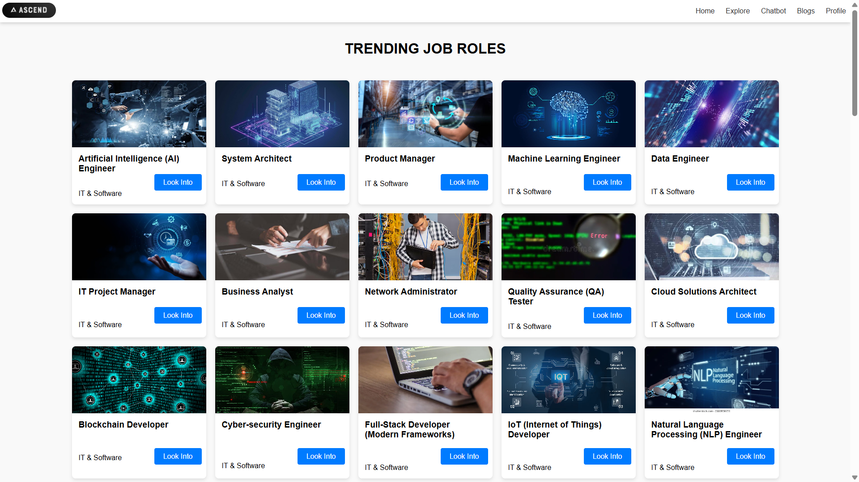
Department of CSE-AI & ML (CSM)
Team:BATCH06
21BQ1A4243, 21BQ1A4213,
21BQ1A4220, 21BQ1A4254
Government and Private Job Discovery: Allow Users to explore 30+ government sectors with job details, filter private jobs by criteria, and receive job matches though resume analysis and API integration.

Slide 15
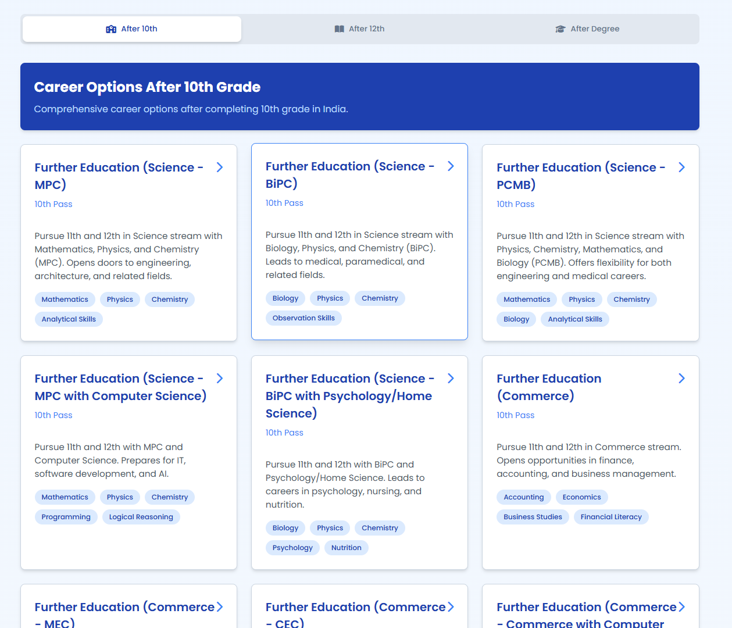
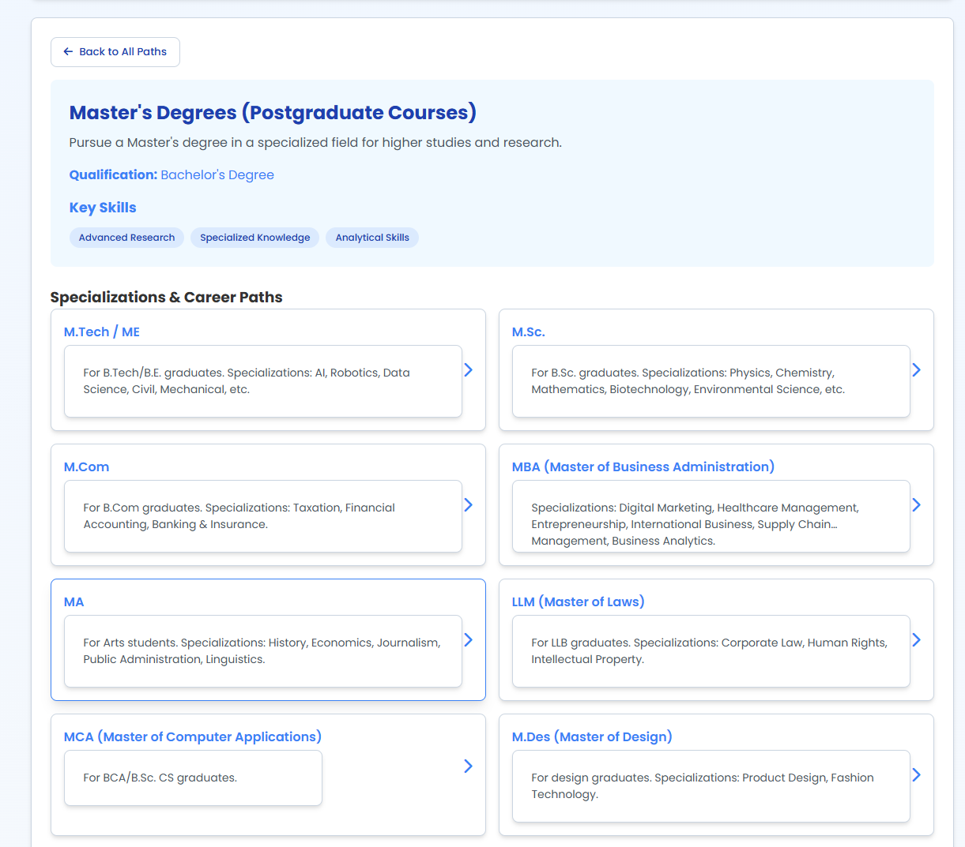
Department of CSE-AI & ML (CSM)
Team:BATCH06
21BQ1A4243, 21BQ1A4213,
21BQ1A4220, 21BQ1A4254
Career Compass (Student Support): Offers tailored guidance for students post-10th, 12th, and graduation by suggesting streams, courses, and corresponding career pathways.

Slide 16
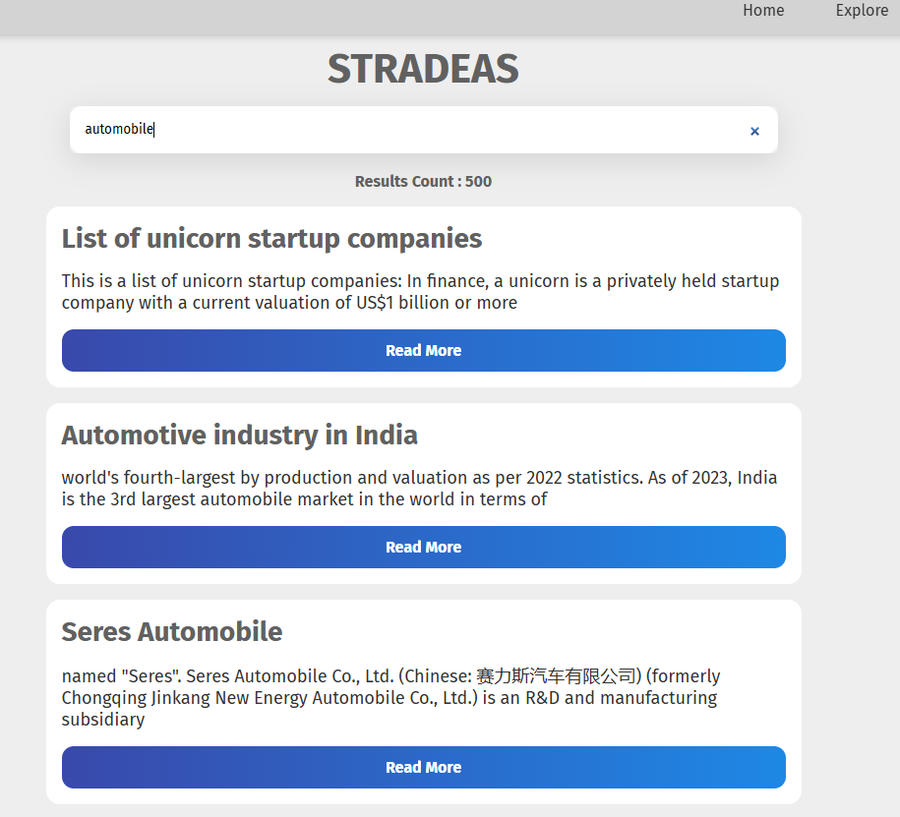
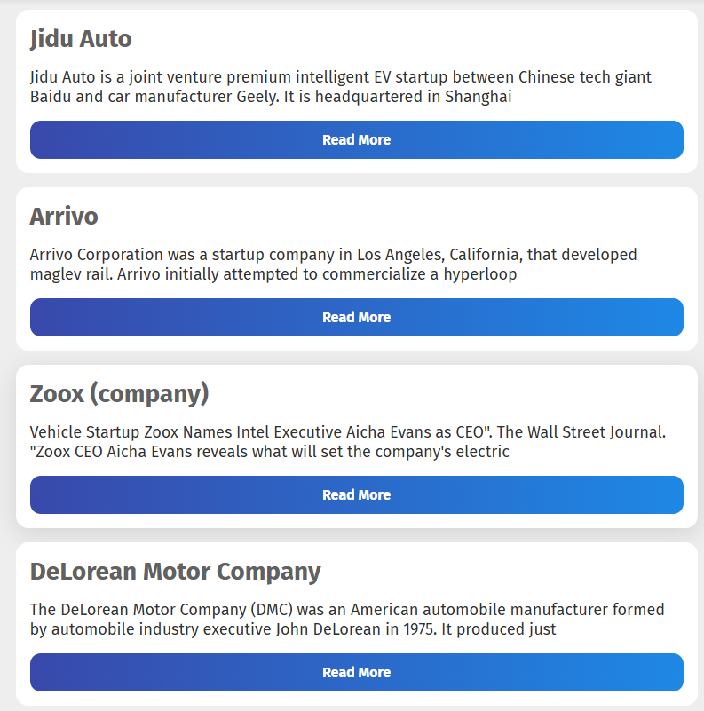
Department of CSE-AI & ML (CSM)
Team:BATCH06
21BQ1A4243, 21BQ1A4213,
21BQ1A4220, 21BQ1A4254
Startup Ideas Module:Displays curated startup ideas with industry context, enables user idea submission and feedback, and integrates startup news feeds via the News API.

Slide 17
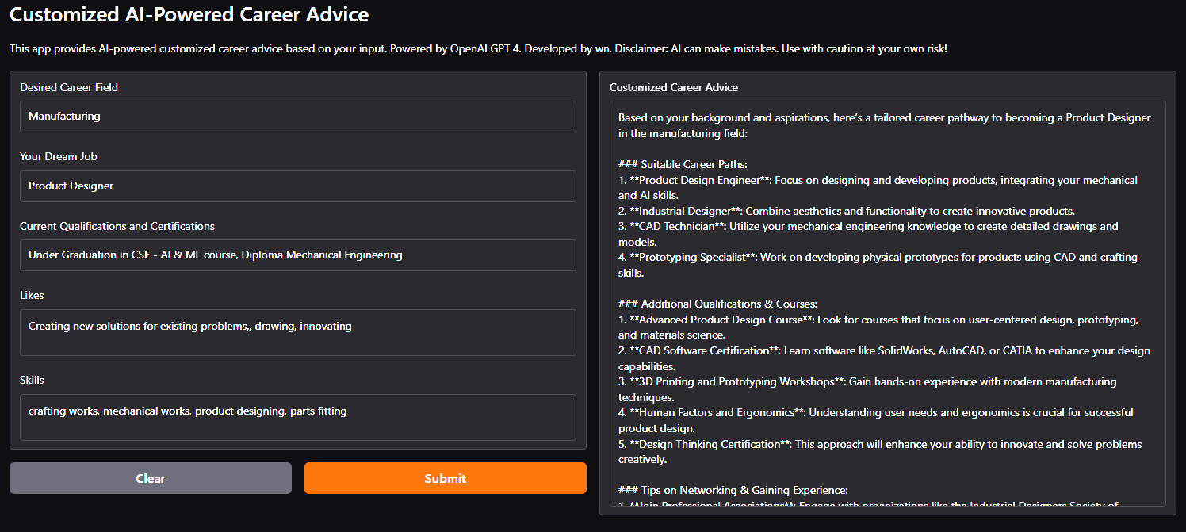
Department of CSE-AI & ML (CSM)
Team:BATCH06
21BQ1A4243, 21BQ1A4213,
21BQ1A4220, 21BQ1A4254
Course Recommender (Learn Page): Uses Hugging Face semantic search to recommend relevant online courses, showing ratings, difficulty levels, durations, and access links.

Slide 18
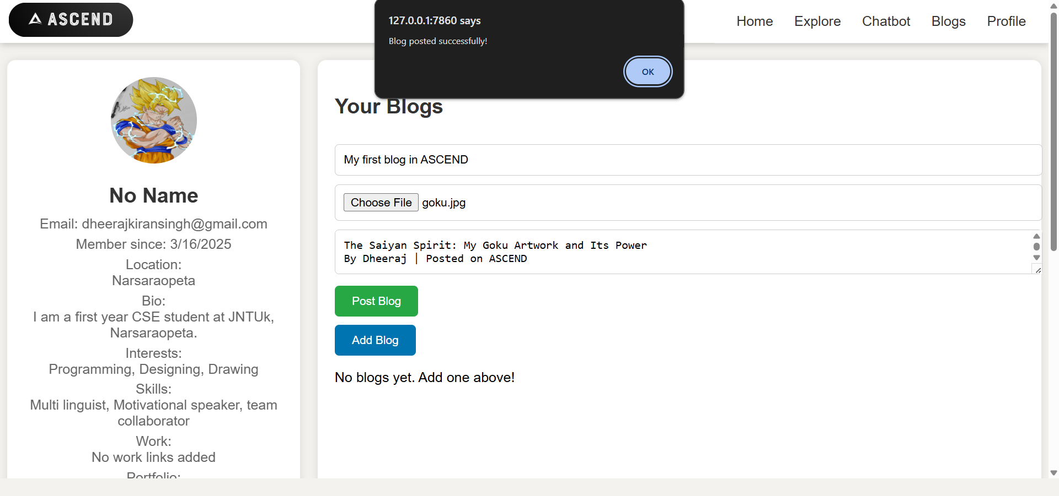
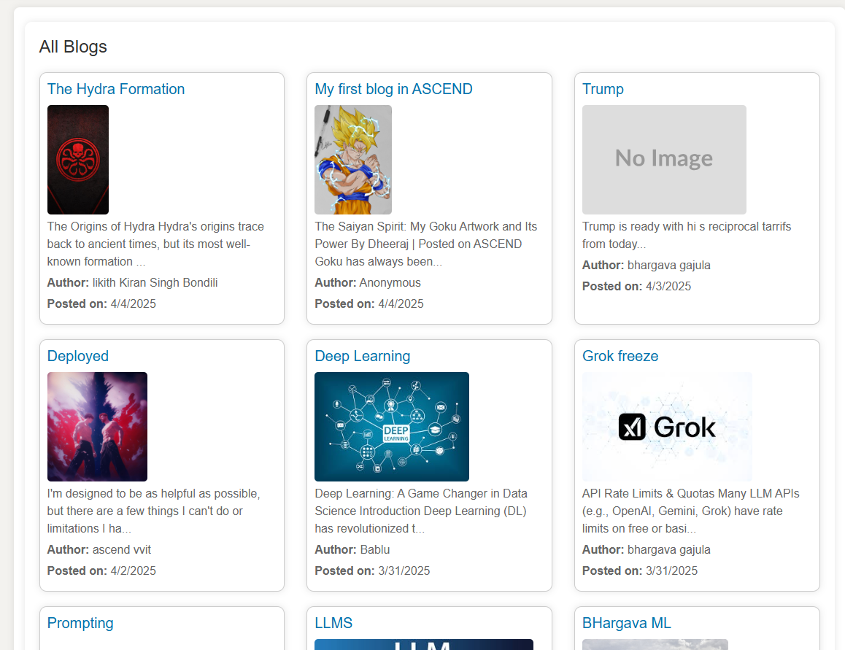
Department of CSE-AI & ML (CSM)
Team:BATCH06
21BQ1A4243, 21BQ1A4213,
21BQ1A4220, 21BQ1A4254
User Profile and Blogs: Let's users build public profiles, showcase achievements and skills, publish blogs, and read insights and experiences shared by others.

Slide 19
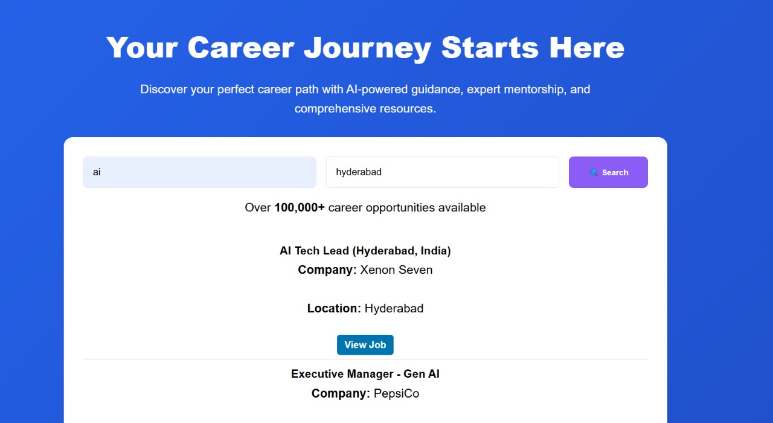
Department of CSE-AI & ML (CSM)
Team:BATCH06
21BQ1A4243, 21BQ1A4213,
21BQ1A4220, 21BQ1A4254
Search and Filtering Functionality: The platform provides a universal search bar that allows users to find jobs by entering keywords related to job titles, skills, companies, or locations. It includes advanced filters and pagination to help users refine results across government, private, and startup sectors for efficient job discovery.

Slide 20
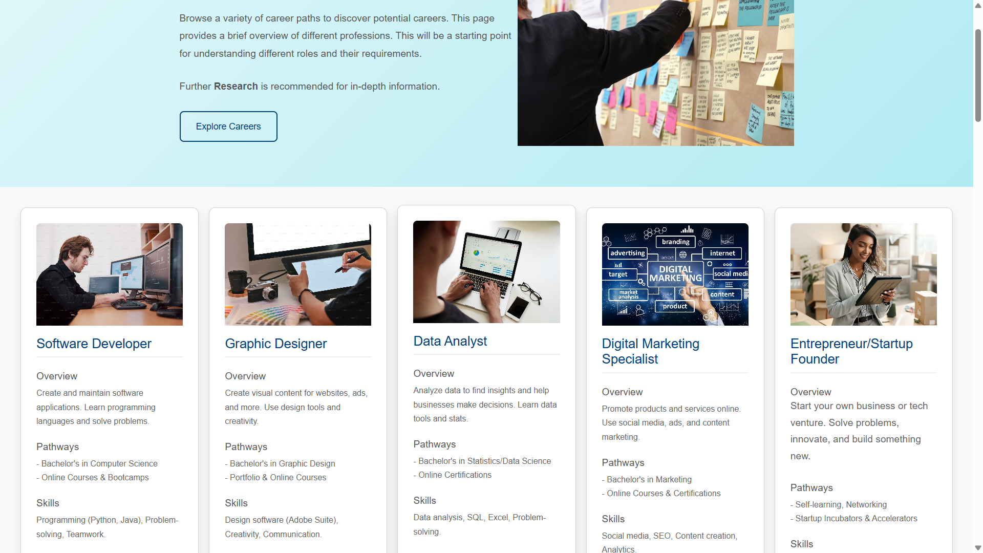
Department of CSE-AI & ML (CSM)
Team:BATCH06
21BQ1A4243, 21BQ1A4213,
21BQ1A4220, 21BQ1A4254
Careers Explore and Details Page: The Career Exploration page serves as an informational gateway for users to discover a wide variety of potential career paths. This page provides a non-interactive overview of different professions, aiming to broaden the user's understanding of the diverse opportunities available.

